Slide 1
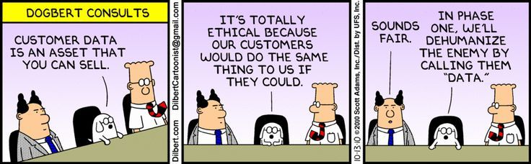
Logistic and ordered logistic regression CP 201B
Daniel A. Rodriguez

Slide 2
Learning objectives
Understand origin and application of bi-variate linear regression
Interpret results and output
Estimate in packages

Slide 3
Outline of the day

Slide 4
Logistic regression models are appropriate for dependent variables coded 0/1.
Variables are “limited” –other types of variables that are ‘limited’ are ordered categories, counts
We only observe “0” and “1” for the dependent variable—but we think of the dependent variable conceptually as a probability that “1” will occur.

Slide 5
Does your house have piped water? Paved roads? Transit service within X distance?
Is the neighborhood exceeding air quality standards for average daily PM2.5?
Are you past due in your mortgage payment? Are you in default? Has the property been repossessed? Have you been evicted?
Did you walk? Did you use transit? Do you meet physical activity guidelines?
Do you have diabetes? Hypertension? Positive screen for depression?

Slide 6
Histogram of binary variable and non-normality
Recall that one assumption of linear regression is that the dependent variable is normally distributed (and as a result, the errors too).

Slide 7
Plotted on two dimensions, a binary dependent
Plotted on two dimensions, a binary dependent variable would look as follows
Y (for example, walked y/n)
Reminder: For bivariate regression plot looked like this
Y=1
Y=0
X (for example, income normalized)

Slide 8
First intuition: fit a linear regression
Blue line
Y
Y=1
X

Slide 9
Concerns with using linear regression here
If we use linear regression, we’ll get predicted values that fall between 0 and 1—which is what we want—but we’ll also get predicted values that are greater than 1, or less than 0. That makes little sense
There will be heteroscedasticity! How would the errors look like with income on the X axis?
We use logistic or probit regression instead
They conveniently keep values between 0 and 1…but there’s a more important reason

Slide 10
Why use a model that limits predictions to be between 0 and 1?
Y (walked y/n)
We observe 0s and 1s
But for the same income, people behaved differently
Better described as a probability
Unobserved factors (taste, other vars)
Measurement error
Probability is between 0 and 1
Y=1, Yes
X (Z-income)

Slide 11
The underlying situation is a probability between 0 and 1
Y (walked y/n)
Y=1, Yes
Y=0, No
X (Z-income)

Slide 12
The underlying situation is a probability between 0 and 1
Y (walked y/n)
Y=1, Yes
What I observe is the orange dot What I’m interested in is the black dot
Y=0, No
X (Z-income)
The observed dependent variable is a binary variable. But what we are really interested in is predicting the probability that an event occurs (i.e., the probability that y=1)

Slide 13
Some basic definitions
Since we are dealing with probabilities, some confusing definitions and possible ranges of values need to be discussed
P_{i} = probability that event i occurs; ranges between what values?
P_{i}/(1-P_{i}) = odds of event i occurring; ranges between what values?
(0, + infinity)
If the P of faculty member walking to Wurster is 0.8, what are the odds?
If P of student walking is 0.9, what are the odds?
If P of staff walking is 0.5, what are the odds?
Odds of 1 means 50-50 chance….

Slide 14
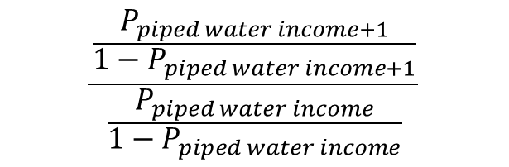
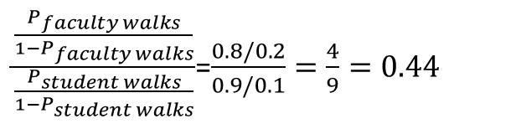
Some basic definitions
Odds ratio (a ratio of odds): comparison of odds for two groups
For example, odds ratio of faculty walking relative to student
Conversely, the odds ratio of students walking, relative to faculty is…..
For example, odds ratio of having piped water for one unit higher income
$\frac{\frac{P_{faculty walks}}{{1−P}_{faculty walks}}}{\frac{P_{student walks}}{{1−P}_{student walks}}}$=$\frac{0.8/0.2}{0.9/0.1}=\frac{4}{9}=0.44$
$$\frac{\frac{P_{piped water income+1}}{{1−P}_{piped water income+1}}}{\frac{P_{piped water income}}{{1−P}_{piped water income}}}$$

Slide 15
Logistic regression
To run a logistic regression, we borrow from linear regression. The right hand side is identical!
But the dependent variable in the equation is the natural log of the odds of the event being 1. Range is (–inf, inf) just like how linear regression likes it
Remember, we don’t “observe” Pi in our data, we only see whether the variable is 1 or 0.

Slide 16
Logistic regression
Dependent variable has to be 1 or 0
Independent variables (X_{i}) can be continuous, ordinal, dummy variables

Slide 17
Logistic regression
Three ways to interpret results
1) Easiest to conduct, hardest for audience:
For every one unit change in X_{i}, the log odds of P_{i} (relative to non-P_{i}) changes (increases or decreases) by b_{i}, holding all other variables in the model constant

Slide 18
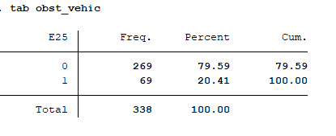
Example
Vehicle obstacles, Bogota street segment data
Is neighborhood density related to having obstacles on pedestrian right of way?
Dichotomous variable
Hard to read/interpret scatterplot

Slide 19
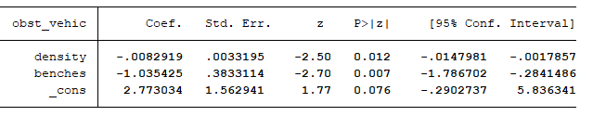

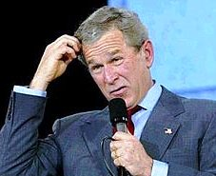
Example
Vehicle obstacles, Bogota street segment data
Density is continuous:
For every increase in 1 persons per hectare, the log odds of having a vehicle blocking the sidewalk (versus not) decreases by -0.0082
Benches is a dummy:
When there are benches (equivalent to an increase from 0 to 1 in benches), the log odds of having a vehicle blocking the sidewalk (versus not) decreases by -1.03

Slide 20
Logistic regression
Three ways to interpret results
2) A tiny bit harder to conduct, still hard for audience:
(exp b_{i}) = change in the odds ratio –See me for detailed explanation

Slide 21
A brief detour: exponential values and natural logs
”exp” is the exponential function. Ln is the natural log. These are opposites.
When we take the exponential function of any number, we take 2.72 raised to the power of that number. So, exp(3)= e³ = 2.72*2.72*2.72=20.09
Conversely, if we take ln (20.09), we get the number 3.
ln(y)=x means that e^{x} = y
Therefore, ln(1) =0 because e⁰= 1
ln(0) is undefined
ln(number close to zero) is {fill in blank ???} because e^{X}= is close to zero
ln(very large number) = large number

Slide 22

Logistic regression
Three ways to interpret results
2) A tiny bit harder to conduct, still hard for audience:
(exp b_{i}) = change in the odds ratio –See me for detailed explanation
For every one unit change in X_{i}, the odds ratio of P_{i} (relative to non-Pi) changes (increases or decreases) by exp(b_{i}), holding all other variables in the model constant

Slide 23
Vehicle obstruction results, now in odds ratios
------------------------------------------------------------------------------
obst_vehic | Odds Ratio Std. Err. z P>|z| [95% Conf. Interval]
-------------+----------------------------------------------------------------
density | .9917424 .0032921 -2.50 0.012 .9853109 .9982158
benches | .3550754 .1361044 -2.70 0.007 .1675118 .7526548
_cons | 16.00712 25.01819 1.77 0.076 .7480588 342.5239
------------------------------------------------------------------------------
As change in odds ratios
Density is continuous:
For every increase in 1 person per hectare, the odds of having a vehicle blocking the sidewalk (versus not) decreases by a factor of 0.9917
Benches is a dummy:
When there are benches (equivalent to an increase from 0 to 1 in benches), the odds of having a vehicle blocking the sidewalk (versus not) decreases by a factor of 0.35

Slide 24
Vehicle obstruction results, now in odds ratios
------------------------------------------------------------------------------
obst_vehic | Odds Ratio Std. Err. z P>|z| [95% Conf. Interval]
-------------+----------------------------------------------------------------
density | .9917424 .0032921 -2.50 0.012 .9853109 .9982158
benches | .3550754 .1361044 -2.70 0.007 .1675118 .7526548
_cons | 16.00712 25.01819 1.77 0.076 .7480588 342.5239
------------------------------------------------------------------------------
As change in odds ratios
As unexponentiated coeffs
If original coefficient is zero, change odds ratio will be 1 → no change!
If original coefficient is negative, then change in OR is < 1

Slide 25
Now the full output
Baseline “noise” or error
Test of model significance
Iteration 0: log likelihood = -171.0588
Iteration 1: log likelihood = -163.63324
Iteration 2: log likelihood = -163.38711
Iteration 3: log likelihood = -163.38616
Iteration 4: log likelihood = -163.38616
Logistic regression Number of obs = 338
LR chi2(2) = 15.35
Prob > chi2 = 0.0005
Log likelihood = -163.38616 Pseudo R2 = 0.0449
------------------------------------------------------------------------------
obst_vehic | Coef. Std. Err. z P>|z| [95% Conf. Interval]
-------------+----------------------------------------------------------------
density | -.0082919 .0033195 -2.50 0.012 -.0147981 -.0017857
benches | -1.035425 .3833114 -2.70 0.007 -1.786702 -.2841486
_cons | 2.773034 1.562941 1.77 0.076 -.2902737 5.836341
------------------------------------------------------------------------------
Final error
Overall fit=
1—(baseline/final error)

Slide 26
Vehicle obstruction results, now in odds ratios
Iteration 0: log likelihood = -171.0588
Iteration 1: log likelihood = -163.63324
Iteration 2: log likelihood = -163.38711
Iteration 3: log likelihood = -163.38616
Iteration 4: log likelihood = -163.38616
Logistic regression Number of obs = 338
LR chi2(2) = 15.35
Prob > chi2 = 0.0005
Log likelihood = -163.38616 Pseudo R2 = 0.0449
------------------------------------------------------------------------------
obst_vehic | Coef. Std. Err. z P>|z| [95% Conf. Interval]
-------------+----------------------------------------------------------------
density | -.0082919 .0033195 -2.50 0.012 -.0147981 -.0017857
benches | -1.035425 .3833114 -2.70 0.007 -1.786702 -.2841486
_cons | 2.773034 1.562941 1.77 0.076 -.2902737 5.836341
------------------------------------------------------------------------------
Look for overall model fit
Look for significance of coefficients
Look for sign of coefficients –do they make sense?
Write out equation
From linear regression:
Try to interpret magnitude of effect (practical relevance)
What would be the predicted probability that a given segment with density of 469 pers/hec and benches on it had a vehicle
obstructing the path?
Ln(p/1-p) =2.773 + -0.00829*density + -1.0354*benches
Ln(p/1-p) =2.773 + -0.00829*density + -1.0354*benches
Notes:
Interpretar coeficientes
26

Slide 27
Logistic regression
Three ways to interpret results
3) Use predicted probabilities: more work for us, but better for reader!!

Slide 28
Logistic regression
3) Use predicted probabilities: more work for us, but better for reader!!
I can now re-estimate the predicted probability but for different values of density (say 400, 450, 500, 550, 600)
Or I can use the density values in the data
Scale of y-axis!
No benches
Yes benches
It’s negative, as estimated
Steeper at beginning,
tapering off as density goes
up

Slide 29
Logistic regression
An image says a thousand words…
Effect of benches almost doubles probability
It’s greater in absolute magnitude at low densities

Slide 30
What could I have improved in my image?
Improvements (so many!)
Label axes
Chart title
Different colors for benches=0, 1
Legend
Connect lines
Include confidence intervals…
But the main point remains: this shows you how the probability of encountering an obstacle in a segment changes with density.

Slide 31
Let’s practice
Copenhaguen data on 1681 residents of 12 areas in city (Madsen, 1976)
Dependent variable: reported satisfaction with housing conditions (1=low, 2=medium, 3=high) → satisfy_hi = 1 if high satisfaction, otherwise = 0
Independent variables:
the type of housing they had (1=apartments, 0 otherwise),
their feeling of influence on apartment management (1=low, 2=medium, 3=high),
their degree of contact with neighbors (1=low, 2=high)
Run logistic regression
Please create python jupyter that turns dependent variable into a binary variable and run
Logit regression and logistic regression (that is reporting raw coeffs and with ORs)

Slide 32
Let’s practice
What is the model fit?
Which coeffs are statistically significant?
Are the coeffs raw (unexponentiated) or in odds ratio?
Interpret unexponentiated coefficients
The log odds of being highly satisfied for those who report feeling high influence on management increase by 0.65 than for those who didn’t report feeling high influence, all other variables in the model held constant
Those who report high degree of contact with neighbors have 0.21 higher log odds of being highly satisfied than those who report low degree of contact, all else held equal
Those living in apartments have -0.08 lower log odds of reporting high satisfaction than those living in non-apartments, all else held equal” –but it isn’t statistically significant! So the correct response would be “I didn’t detect a significant association between living in apartments and satisfaction.”

Slide 33
Let’s practice
As odds ratios
“Those who report feeling high influence on management have 1.9 higher odds of being highly satisfied than those who didn’t report feeling high influence, all other variables in the model held constant (AOVITMHC)”
“Those who report high degree of contact with neighbors have 1.24 higher odds of being highly satisfied than those who report low degree of contact AOVITMHC”
“For those living in apartments the odds of reporting high satisfaction decreases by 0.91 relative to those living in non-apartments” –but it isn’t statistically significant! So the correct response would be “I didn’t detect a significant association between living in apartments and satisfaction.”

Slide 34
Is collinearity an issue?
| apts influe~e contact
-------------+---------------------------
apts | 1.0000
influence | 0.0585 1.0000
contact | 0.0181 -0.1010 1.0000
Variable | VIF 1/VIF
-------------+----------------------
influence | 1.01 0.986155
contact | 1.01 0.989218
apts | 1.00 0.995997
-------------+----------------------
Mean VIF | 1.01

Slide 35
And, finally, a plot – though not pretty, yet!
Predict probability
Plot probability (y-axis) and influence (low, med high) in X

Slide 36
Ordered logistic regression
When you have three or more response categories, and order matters
If order does not matter, use multinomial logistic regression = a set of binary logistic regressions
We assume that impact of a variable holds across categories
In Copenhagen data, if housing satisfaction has three categories (low, med, high): The impact of contact with neighbors is the same in moving from low to medium satisfaction, than from medium to high
Can be tested, but we won’t
Programs give us the estimates of log odds (or odds ratios), and a set of cutoff values that contribute to determining the predicted probability of an observation being in the low, med, or high categories

Slide 37
Ordered logistic regression
CHIS using health status and access to fresh produce
EXCELLENT (1) | 3,384 16.07 16.07
VERY GOOD (2) | 6,097 28.96 45.03
GOOD (3) | 6,647 31.57 76.60
FAIR (4) | 3,665 17.41 94.01
POOR (50 | 1,262 5.99 100.00
Consider reversing response coding (so that higher values better health)

Slide 38
First a linear regression…impressions?

Slide 39
Ordered Logit
Only new piece is this box showing us cutoff values…only helpful in predicting probabilities…. So ALL OTHER INTERPRETATION STEPS REMAIN

Slide 40
Write Up
People differ in how they treat the write up of coefficient values
Personally, I first focus on direction and then on “amount” represented by the coefficient. DIRECTION IS KEY!
Access to fresh fruits and vegetables in the neighborhood significantly increased a person’s self-reported health status, even after controlling for behavioral and socio-economic differences.

Slide 41
Write Up –more precise
Having access to fresh fruits and vegetables in the neighborhood was associated with 1.25 higher odds of being in a higher category, relative to a lower one, even after controlling for behavioral and socio-economic differences.

Slide 42
Final example for practice…estimate yourself
Copenhagen data
Dependent variable: reported satisfaction with housing conditions (1=low, 2=medium, 3=high)
Independent variables:
the type of housing they had (1=apartments, 0 otherwise),
their feeling of influence on apartment management (1=low, 2=medium, 3=high),
their degree of contact with neighbors (1=low, 2=high)
Run ordered logistic regression

Slide 43
Results (left logit; right o-logit)

Slide 44
Putting it all Together: Building a Model
Develop your theory and “floors and bricks” for how your explanatory variables are associated with your dependent variable
Run descriptive summaries; understand distribution of each variable; check for outliers, missing data, and do desired coding/transformations
Pick your “functional” form for the model
Linear? (is my dependent variable continuous?)
Logit? (is my dependent variable a dummy?)
Ordered Logit? (is there an order to my categorical variable?)
Run a correlation and/or simple regression between ALL the potential relationships in the model
Do they pass the sniff test?
Are two variables basically measuring the same thing? Do I run the risk of serious issues related to multicollinearity?
Notes:
“needed transformation” – we are not covering this in lecture, hopefully will get to it in lab, or if not, in subsequent lectures.

Slide 45
Putting it all Together: Building a Model
Run the model
Is the model significant? [p value for F-test or Chi-Square]
Are the variables significant? [p value for t-tests]
Are the signs of the coefficients consistent with theoretical expectations?
Diagnostics
Checking for multicollinearity
Checking for constant error variance (homoscedasticity) and normal distribution of errors
Write up
Notes:
“Robustness tests”: Do coefficients change drastically when using different specifications of the model? Do they change if we enter a different transformation of a variable? If we exclude outliers?

Slide 46
Write Up
Always include a descriptive table of your variables in the model
Common metrics include mean, median, standard deviation, and percent of sample for dummy variables, and your N
What share of people did report good health over poor health? What was the median amount of remittances? What was the percent people of color in LIHTC tracts compared to non-LIHTC tracts?
I really like it when authors include information about the association between the “key” explanatory variable and outcome or dependent variable before adding in controls
How do these two co-vary?
Could be a bar graph, a simple ttest or prtest, a correlation
Model results
Always include either your coefficient or odds ratio, and some measure of significance. Stars are great, but also either include p-value or t-statistic
Organize your model table
Putting the “bricks” from your “floors” together in groupings is super helpful for your reader, rather than just a long list of variables

